Slide 1
Simulation Modeling and Performance Evaluation
Lecture 05
Simulation Development Example
Single Server Queueing System (SSQS)
Muhammad Mahbub Alam
Professor
CSE Department, IUT

Slide 2
SSQS – Step 3: Specification Model (1/14)
1. State Equations (1/2)
Let l(t) is the state variable representing the number of customers in the system
Then the state equations is

Slide 3
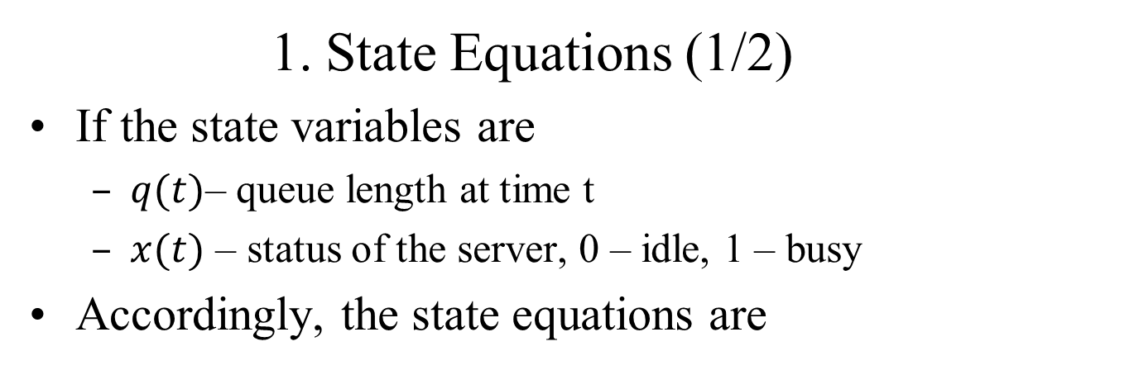
SSQS – Step 3: Specification Model (2/14)
1. State Equations (1/2)
If the state variables are
$q(t)$– queue length at time t
$x(t)$ – status of the server, 0 – idle, 1 – busy
Accordingly, the state equations are

Slide 4
SSQS – Step 2: Conceptual Model (7/10)
4. State Space
State variable (server status, queue length)
System state is a set of two element
X is (0,0), (1, 0), (1, 1), (1, 2), (1, 3), …
State variable (total customer in the system)
X is 0, 1, 2, …

Slide 5
SSQS – Step 2: Conceptual Model (8/10)
5. Feasible event set at state x
State variable (server status, queue length)
X is (0,0), (1, 0), (1, 1), (1, 2), (1, 3), …
At state (0,0): only arrival
Other states: both arrival and departure
State variable (total customer in the system)
X is 0, 1, 2, …
Arrival event: state 0
Both arrival and departure events: states 1, 2, 3, …

Slide 6
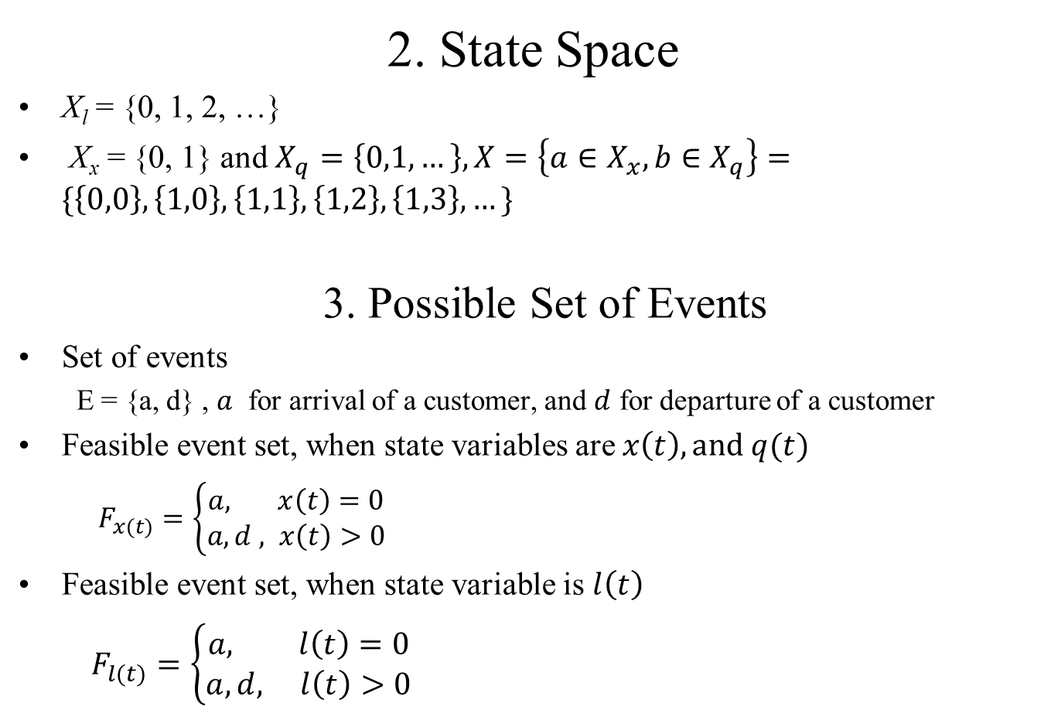
SSQS – Step 3: Specification Model (3/14)
2. State Space
X_{l} = {0, 1, 2, …}
X_{x} = {0, 1} and $X_{q}=\left\{0,1,…\right\}, X=\left\{a∈X_{x}, b∈X_{q}\right\}=\{\left\{0,0\right\},\left\{1,0\right\}, \left\{1,1\right\}, \left\{1,2\right\}, \left\{1,3\right\}, …\}$
3. Possible Set of Events
Set of events
E = {a, d} , $a$ for arrival of a customer, and $d$ for departure of a customer
Feasible event set, when state variables are $x\left(t\right), and q(t)$
$F_{x(t)}=\left\{\begin{aligned}a, x\left(t\right)=0 \\ &a,d , x\left(t\right)>0\end{aligned}\right.$
Feasible event set, when state variable is $l\left(t\right)$
$F_{l(t)}=\left\{\begin{aligned}a, l\left(t\right)=0 \\ &a,d, l\left(t\right)>0\end{aligned}\right.$

Slide 7
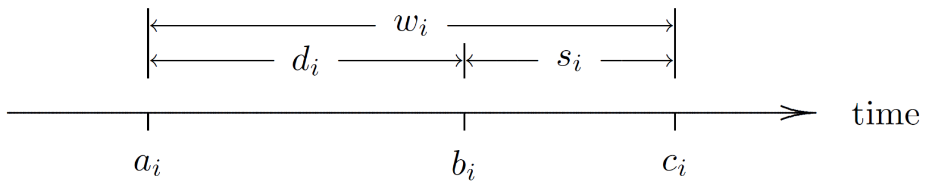
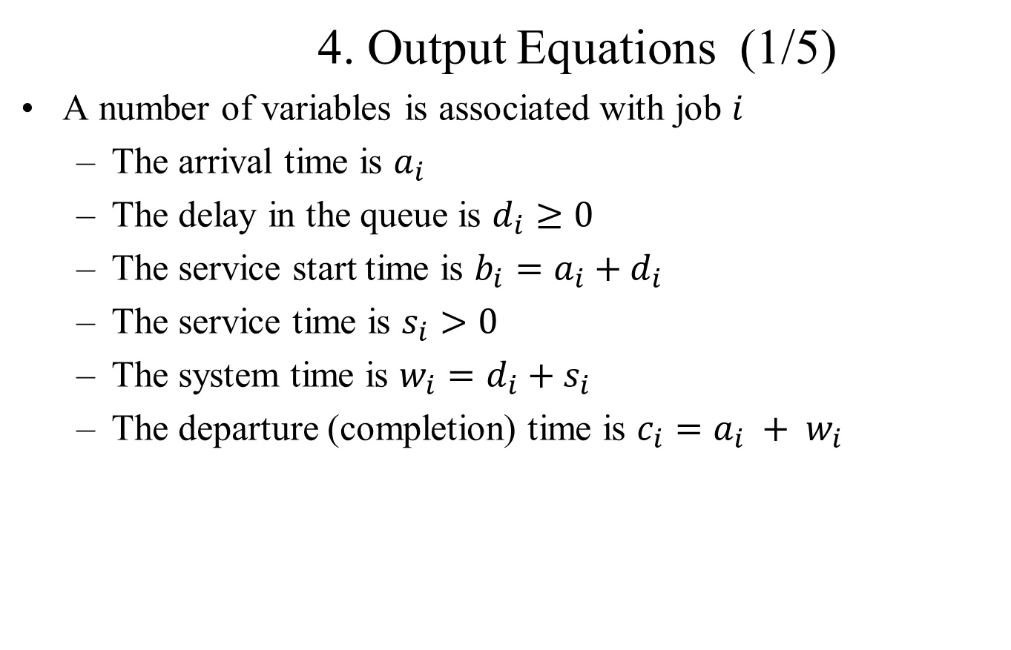
SSQS – Step 3: Specification Model (4/14)
4. Output Equations (1/5)
A number of variables is associated with job $i$
The arrival time is $a_{i}$
The delay in the queue is $d_{i}≥0$
The service start time is $b_{i}=a_{i}+d_{i}$
The service time is $s_{i}>0$
The system time is $w_{i}=d_{i}+s_{i}$
The departure (completion) time is $c_{i}=a_{i} + w_{i}$

Slide 8
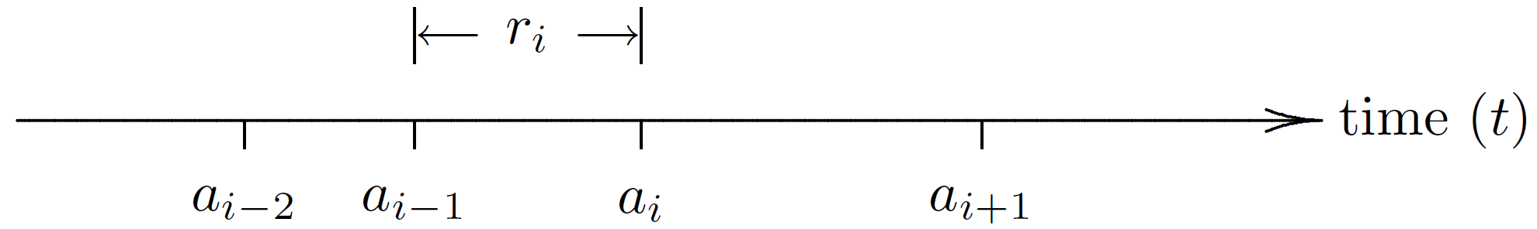
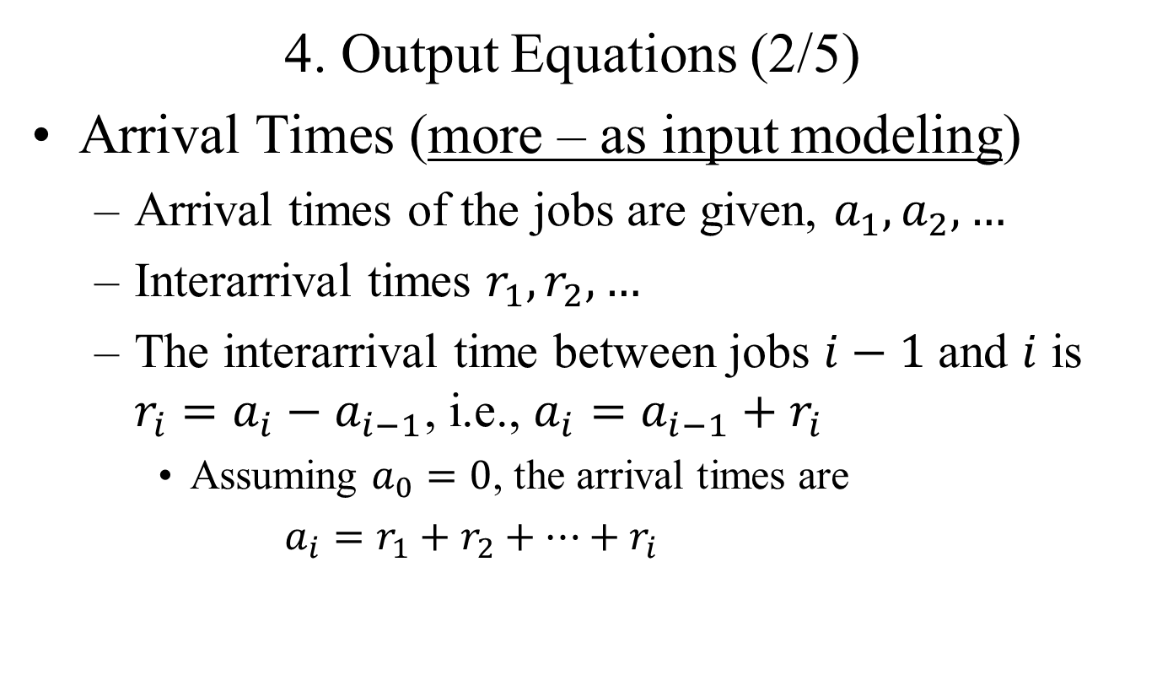
SSQS – Step 3: Specification Model (1/14)
4. Output Equations (2/5)
Arrival Times (more – as input modeling)
Arrival times of the jobs are given, $a_{1}, a_{2}, …$
Interarrival times $r_{1},r_{2},…$
The interarrival time between jobs $i−1$ and $i$ is $r_{i}=a_{i}−a_{i−1}$, i.e., $a_{i}=a_{i−1}+r_{i}$
Assuming $a_{0}=0$, the arrival times are
$a_{i}=r_{1}+r_{2}+⋯+r_{i}$

Slide 9
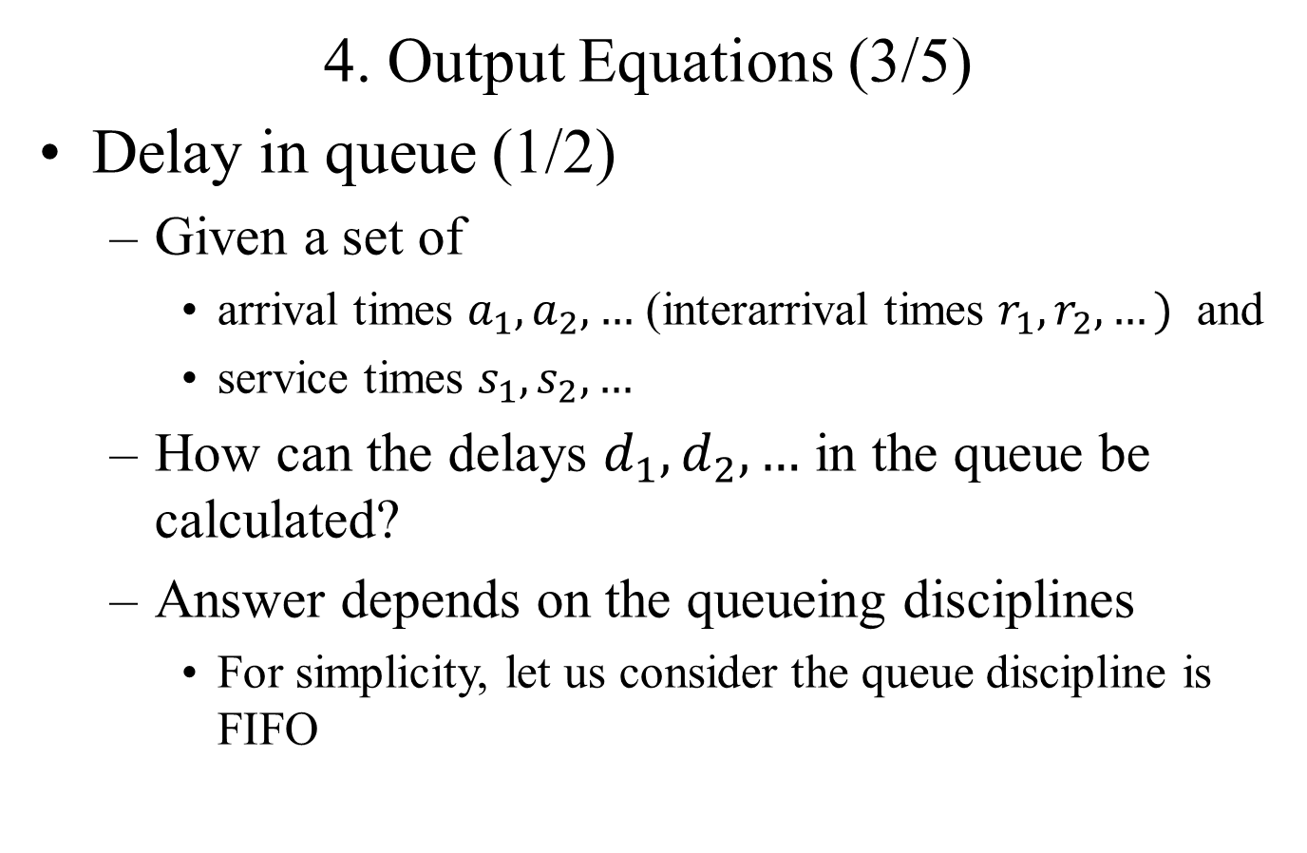
SSQS – Step 3: Specification Model (5/14)
4. Output Equations (3/5)
Delay in queue (1/2)
Given a set of
arrival times $a_{1}, a_{2}, …$ (interarrival times $r_{1},r_{2},…)$ and
service times $s_{1},s_{2}, …$
How can the delays $d_{1},d_{2},…$ in the queue be calculated?
Answer depends on the queueing disciplines
For simplicity, let us consider the queue discipline is FIFO

Slide 10
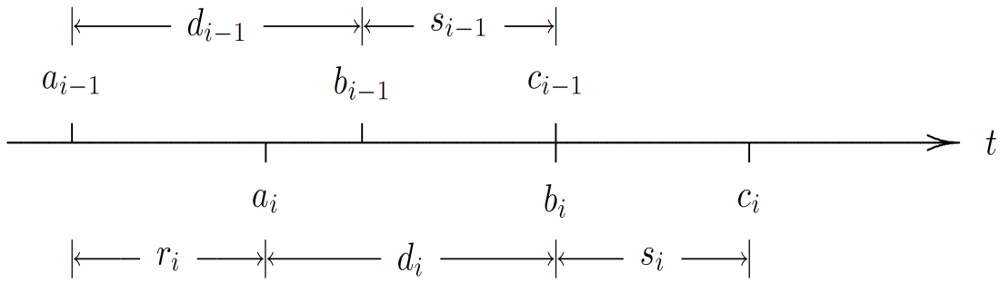
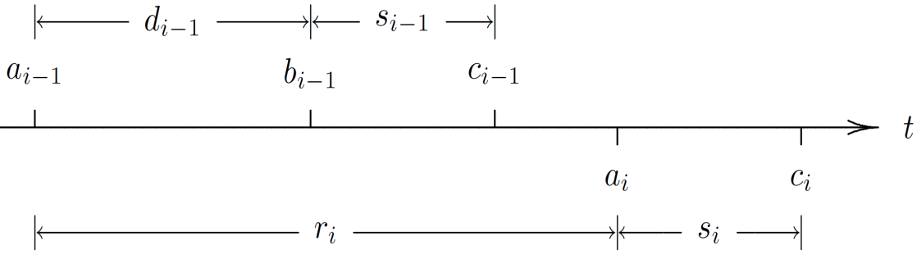

SSQS – Step 3: Specification Model (6/14)
4. Output Equations (4/5)
Delay in queue (2/2)
Case I: $a_{i}<c_{i−1},$ job $i$ arrives before job $i −1$ departs
$d_{i}=c_{i−1}−a_{i}$
Case II: $a_{i}≥c_{i−1},\text{job} i \text{arrives} \text{after} \text{job} i −1 \text{departs}$
$d_{i}=0$

Slide 11
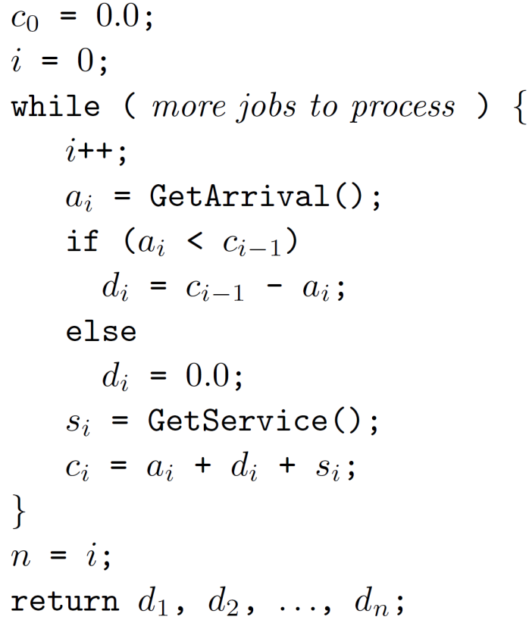
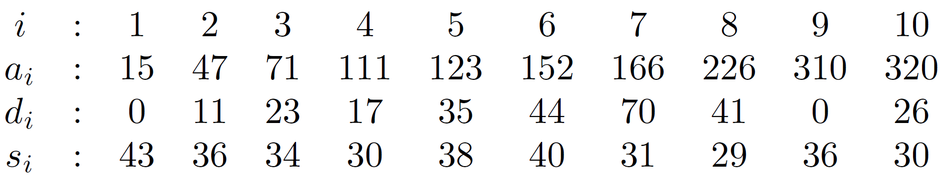

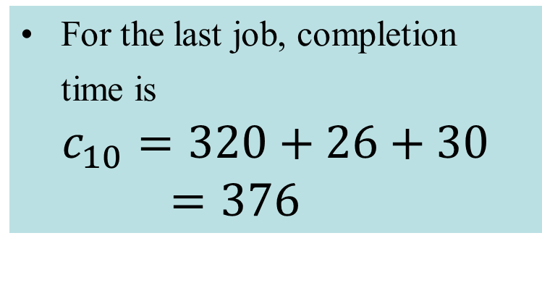
SSQS – Step 3: Specification Model (7/14)
5. A very simple program and delay calculation
For the last job, completion time is
$$c_{10}=320+26+30=376$$

Slide 12
SSQS – Step 3: Specification Model (8/14)
Output Statistics (1/6)
Meaningful statistics depend on decision perspective
Job’s (customer’s) perspective
Average delay of a customer
Management’s perspective
Resource utilization (e.g., server utilization)
How the averaging is done
Job-averaged statistics
Data is averaged over all jobs
Time-averaged statistics
Data is averaged over the time

Slide 13
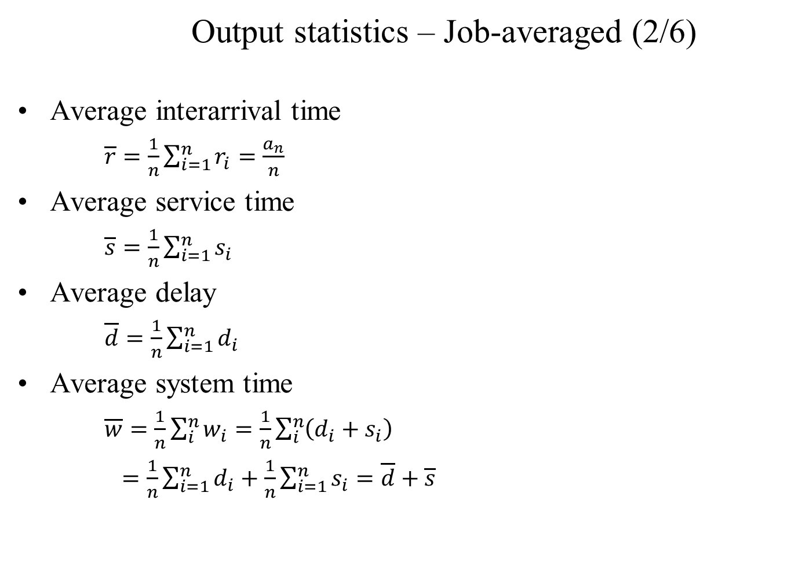
SSQS – Step 3: Specification Model (9/14)
Output statistics – Job-averaged (2/6)
Average interarrival time
$\overline{r}=\frac{1}{n}\sum_{i=1}^{n}{r_{i}=\frac{a_{n}}{n}}$
Average service time
$\overline{s}=\frac{1}{n}\sum_{i=1}^{n}{s_{i}}$
Average delay
$\overline{d}=\frac{1}{n}\sum_{i=1}^{n}{d_{i}}$
Average system time
$\overline{w}=\frac{1}{n}\sum_{i}^{n}{w_{i}}=\frac{1}{n}\sum_{i}^{n}{\left(d_{i}+s_{i}\right) }$
$=\frac{1}{n}\sum_{i=1}^{n}{d_{i}+\frac{1}{n}\sum_{i=1}^{n}{s_{i}}=\overline{d}+\overline{s}}$

Slide 14
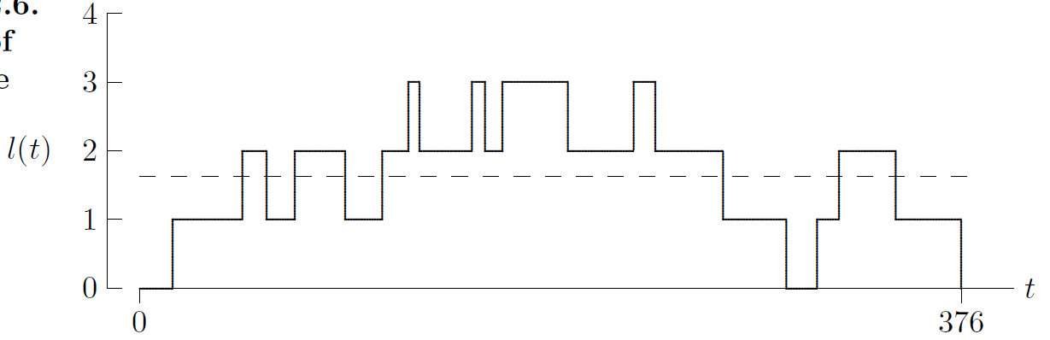
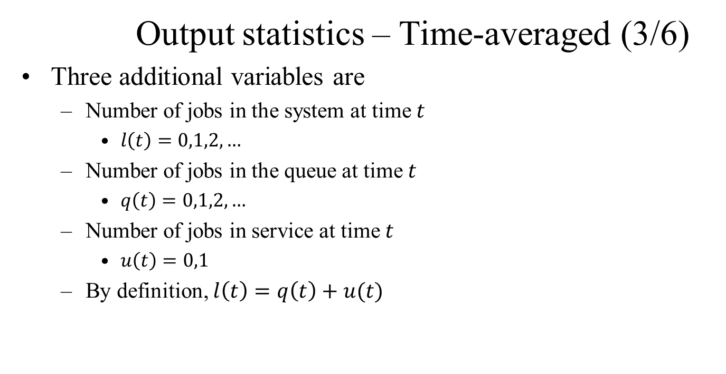
SSQS – Step 3: Specification Model (10/14)
Output statistics – Time-averaged (3/6)
Three additional variables are
Number of jobs in the system at time $t$
$l\left(t\right)=0,1,2, …$
Number of jobs in the queue at time $t$
$q\left(t\right)=0,1,2, …$
Number of jobs in service at time $t$
$u\left(t\right)=0,1$
By definition, $l\left(t\right)=q\left(t\right)+u(t)$
Time-averaged number in the system

Slide 15
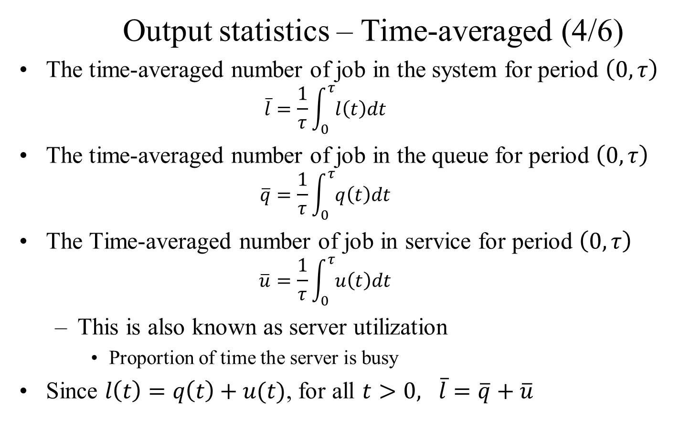
SSQS – Step 3: Specification Model (11/14)
Output statistics – Time-averaged (4/6)
The time-averaged number of job in the system for period $\left(0,τ\right)$
$$\overline{l}=\frac{1}{τ}\int_{0}^{τ}{l\left(t\right)dt}$$
The time-averaged number of job in the queue for period $\left(0,τ\right)$
$$\overline{q}=\frac{1}{τ}\int_{0}^{τ}{q\left(t\right)dt}$$
The Time-averaged number of job in service for period $\left(0,τ\right)$
$$\overline{u}=\frac{1}{τ}\int_{0}^{τ}{u\left(t\right)dt}$$
This is also known as server utilization
Proportion of time the server is busy
Since $l\left(t\right)=q\left(t\right)+u(t)$, for all $t>0, \overline{l}=\overline{q}+\overline{u}$

Slide 17
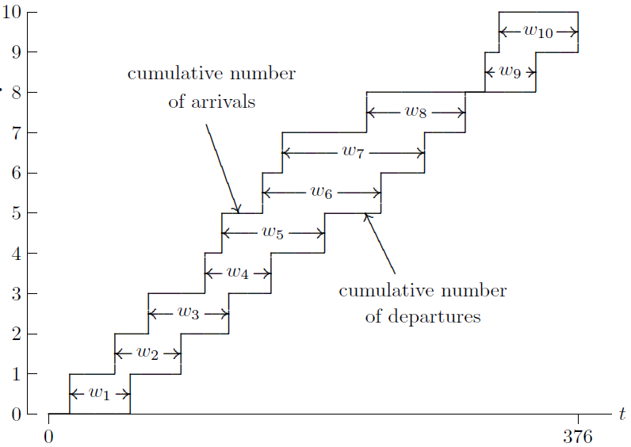
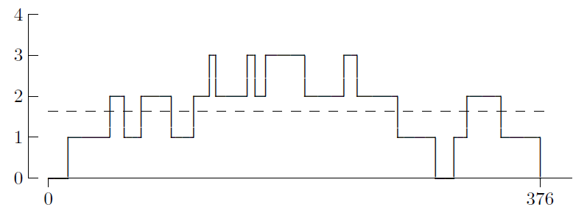

SSQS – Step 3: Specification Model (12/14)
Output statistics – Little Formula (5/6)
How are job averages and time averages are related?
How $\overline{w}, \overline{d},$and$\overline{s}$ are related to $\overline{l}, \overline{q}$ and $\overline{u}$?
$\int_{0}^{τ}{l\left(t\right)dt=\sum_{i=1}^{n}{w_{i}}}$
$\int_{0}^{τ}{q\left(t\right)dt=\sum_{i=1}^{n}{d_{i}}}$
$\int_{0}^{τ}{u\left(t\right)dt=\sum_{i=1}^{n}{s_{i}}}$

Slide 19
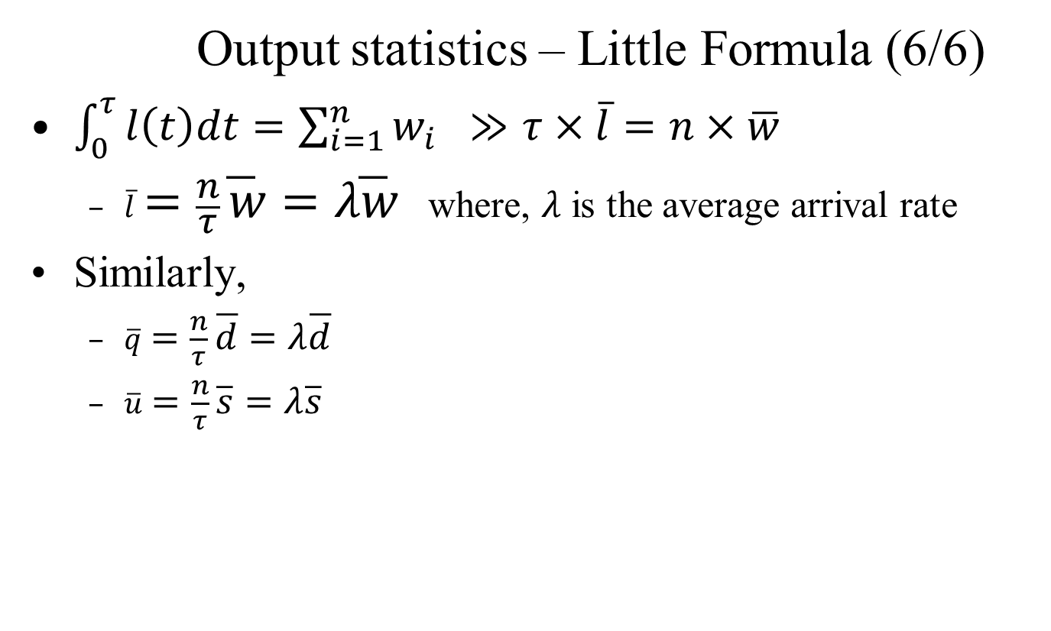
SSQS – Step 3: Specification Model (13/14)
Output statistics – Little Formula (6/6)
$\int_{0}^{τ}{l\left(t\right)dt=\sum_{i=1}^{n}{w_{i}} ≫τ×\overline{l}=n×\overline{w}}$
$\overline{l}=\frac{n}{τ}\overline{w}=λ\overline{w}$ where, $λ$ is the average arrival rate
Similarly,
$\overline{q}=\frac{n}{τ}\overline{d}=λ\overline{d}$
$\overline{u}=\frac{n}{τ}\overline{s}=λ\overline{s}$

Slide 20
SSQS – Step 3: Specification Model (14/14)
Input Data Modeling
Event occurrence time of each of the events
How the time value is calculated
Relative Timing
Absolute Timing
How the data is provided, i.e., source of data
Sample data collection
Random data generation

Slide 21
SSQS – Step 3: Specification Model (14/14)
Input Data Modeling – Absolute Timing
Exact timing w.r.t the simulation start time
Need to know the timing information before starting the simulation
Data must be available before simulation starts
Sort the data
Runtime data generation is not possible
Uncertainty about the data size

Slide 22
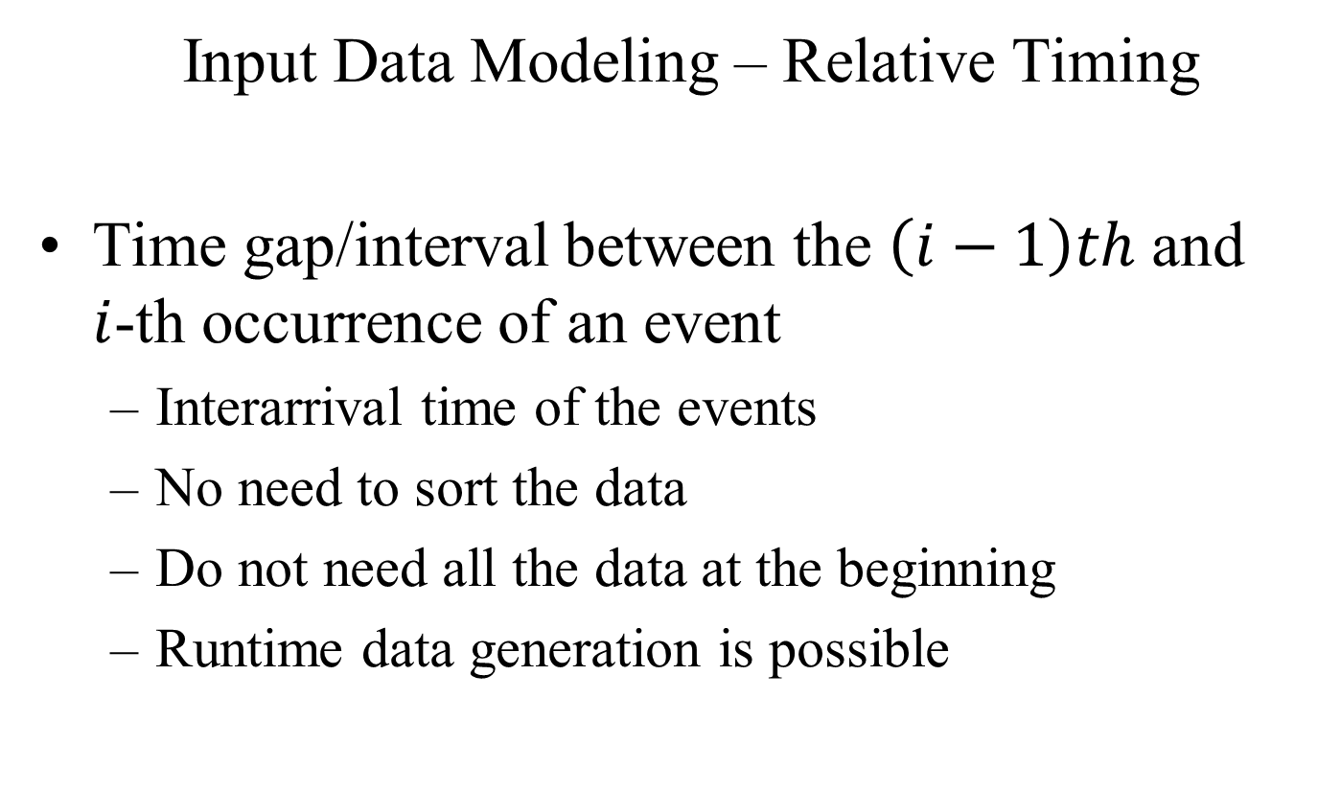
SSQS – Step 3: Specification Model (14/14)
Input Data Modeling – Relative Timing
Time gap/interval between the $\left(i−1\right)th$ and $i$-th occurrence of an event
Interarrival time of the events
No need to sort the data
Do not need all the data at the beginning
Runtime data generation is possible

Slide 23
SSQS – Step 3: Specification Model (14/14)
Input Data Modeling – Source of Data
Sample data
Might not be available
Difficult to collect
Difficult to predict the required data size
Randomly Generated data
Easy to generate
Probabilistic distribution is used
Runtime data generation is possible

Slide 24
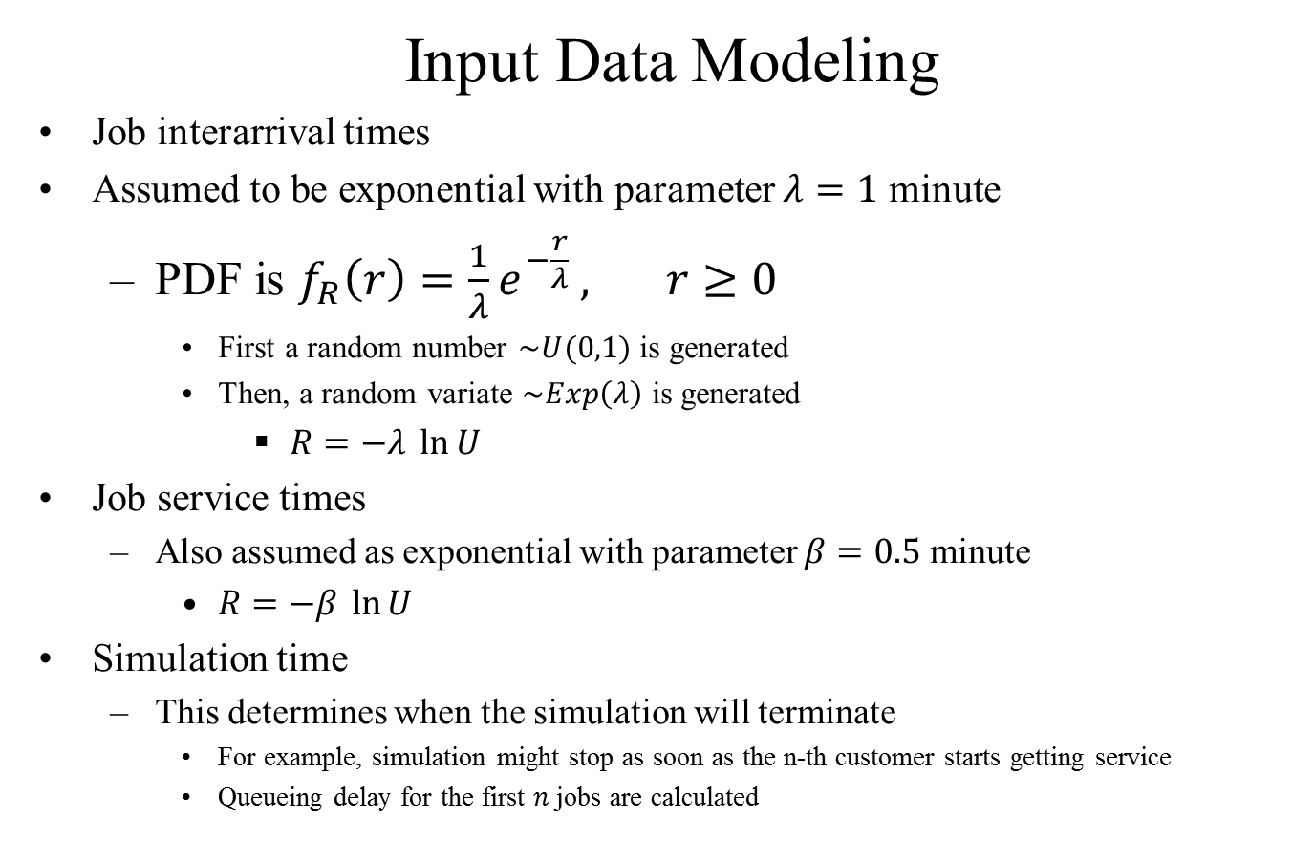
SSQS – Step 3: Specification Model (14/14)
Input Data Modeling
Job interarrival times
Assumed to be exponential with parameter $λ=1$ minute
PDF is $f_{R}\left(r\right)=\frac{1}{λ}e^{−\frac{r}{λ}} , r≥0$
First a random number $\sim U(0,1)$ is generated
Then, a random variate $\sim Exp\left(λ\right)$ is generated
$R=−λ \ln{U}$
Job service times
Also assumed as exponential with parameter $β=0.5$ minute
$R=−β \ln{U}$
Simulation time
This determines when the simulation will terminate
For example, simulation might stop as soon as the n-th customer starts getting service
Queueing delay for the first $n$ jobs are calculated

